Slide 1

INICIATIVA APORTA
Reuse open data
AUGUST 2024

Slide 2




DATA, THE ENGINE OF THE WORLD
The volume of data in the world is growing every year.
Data generated both by companies and by society as a whole.
The data economy in the European Union (EU27) in 2023
Data is a fundamental element to facilitate decision-making and generate economic and social value through innovation.
544 billion euros:
The value of the data economy
9.3% more than 2022
7.7 million:
The number of data professionals
4.7% more than 2022
238,000 units:
The number of data providers
9.2% more than 2022
238,000 units:
The number of data user 3.5% more than 2022
The EU27 data economy is expected to reach 995 billion euros by 2030, representing 6.5% of its GDP
Source: "European Data Market Study 2021-2023", European Union, 2024.

Slide 3
DATA AS A TECHNOLOGICAL BASIS
IN ALL SECTORS
Data is the basis of many technologies that make our lives easier:
Artificial Intelligence (AI)
Big Data
Blockchain
Internet of Things
This makes them an asset for all sectors:
E-health
Personalised education
Efficient public sector
Smart cities
Intelligent Agriculture
Food security
Intelligent Transport
Industry 4.0
Intelligent energy management
Sustainable environmental management

Slide 4


"To support the development of AI and other frontier technologies, Europe needs to exploit the untapped potential of data. Access to data is not only a major driver for competitiveness, accounting for almost 4% of EU GDP, but also essential for productivity and societal innovations, from personalised medicine to energy savings.
"While ensuring high standards of data protection, we will support companies by improving open access to data. (…) Europe needs a data revolution. This is why we will put forward a European Data Union Strategy."
Ursula von der Leyen,
Political guidelines for the next European Commission (2024-2029)
July 2024

Slide 5


EUROPE'S ROLE
IN THE DATA REVOLUTION
Among its lines of action is to promote the exchange of information and the creation of a single market for data where:
Data can flow between countries and economic sectors in the EU.
European standards and values are respected, with particular attention to the protection of personal data.
The rules for data access and use are fair, practical and clear.
The EU has launched a European Data Strategy
with the aim of becoming a leader in a data-driven society
Regulations to be considered:
Open data
Data
governance
European
Data Act
Data from
High Value
IA Act
Directive 2019/1024, promoting the re-use of public sector information
Regulation 2022/868, which facilitates the exchange of data between sectors and between Member
States
Regulation 2023/868, which promotes harmonised rules for fair access and use of data
Implementing Regulation (EU) 2023/138 establishing the list of high value datasets
Regulation (EU) 2024/1689, which constitutes a reference framework for the development of IA systems

Slide 6
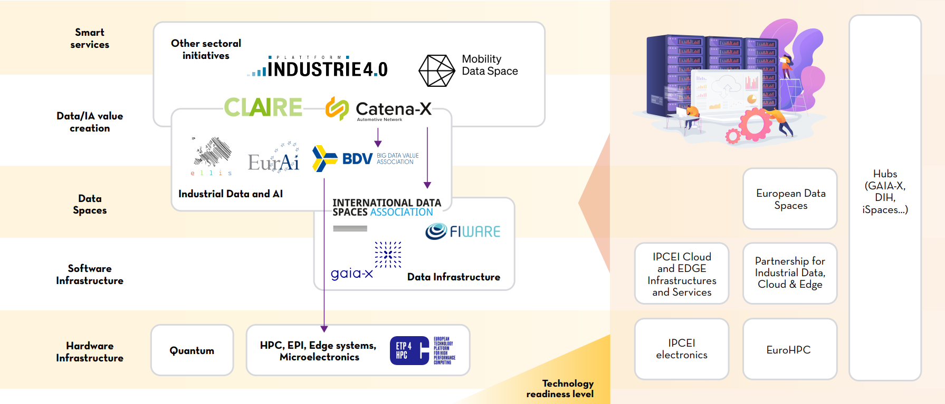


DATA SPACES TO DRIVE INNOVATION
In addition to open data, the EU27 aims to invest in and develop common data spaces in strategic economic sectors and sectors of public interest
Related European initiatives
what are data spaces?
Ecosystem where different actors share data voluntarily and securely, following common governance, organisational, regulatory and technical mechanisms.

Slide 7


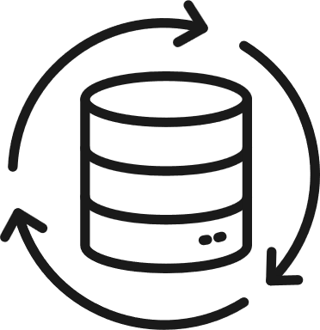
THE SPANISH STRATEGY, IN LINE WITH EUROPE
This European framework is reflected in our country through the Digital Spain 2026 Agenda, which includes, among other aspects:
The need to develop the data economy and artificial intelligence in Spain, applying innovation and experimentation in the use of data in the Administration, promoting and facilitating the creation of:
Accessible data repositories
A cross-cutting platform for shared data from administrations as well as businesses
SOME KEY POINTS
Regulatory and ethical framework for the deployment of AI
Data and technology infrastructures supporting AI, including a National Plan for Natural Language Technologies
Intelligent automation of processes and the development of data-driven public services.

Slide 8




WHAT IS OPEN DATA?
Europe defines open data as:
Data in open formats that anyone can use:
Use
Reuse
Share
For any purpose
THIS DATA IS GENERATED BY ALL OF US:
Administrations
Universities and Researchers
Citizens
Companies

Slide 9

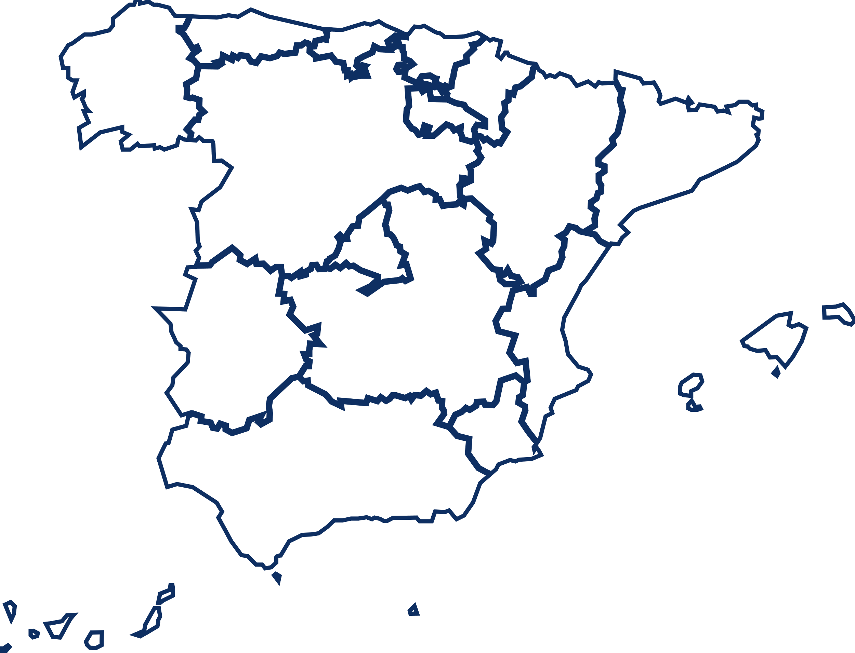
OPEN DATA IN
EUROPEAN AND SPANISH LEGISLATION
Law 37/2007 on the re-use of public sector information
Through directive 2019/1024, Europe calls for the principle of "open by design and by default", ensuring public security and the protection of personal data.
Spain follows the recommendation by following the same principles.
Generalised authorisation
Valuable data
Free reuse
Widespread authorisation to re-use data associated with services provided or funded by the public sector (transport, research, etc.).
Special focus on dynamic and high-value data*:
Machine-readable
Provided through API
Provided by bulk download
Free reuse by default and transparency on possible exclusive agreements.
*High-value data: data with a high potential to generate 'benefits for society, the environment and the economy' (geospatial, environmental, statistical, meteorological, business and mobility data ).

Slide 10



WHO USES OPEN DATA?
Government Bodies
Companies, entrepreneurs, developers, etc.
Citizens
that implement open data solutions to improve the efficiency, effectiveness and transparency of public services.
that generate products and services that have an impact on the economy and society.
who are better informed, with better services and tools in various fields thanks to open data.
Open data is a win-win situation

Slide 11



THE USE OF DATA IN
PUBLIC ADMINISTRATIONS
Public administrations provide open data, but also reuse it for:
Identify patterns that support decision making
Identify areas for improvement, optimise its functioning and better plan resources
Providing better quality services and facilitating interaction with citizens
Energy Datahub,
Junta Castilla y León
Pollen level forecast, Community of Madrid
Digital twin,
City of Denia
It allows to visualise the analysis disaggregated by type of energy and geographical location. It has resulted in savings of €2 million per year since 2015 in fixed electricity costs alone.
They have optimised the reliability of pollen level prediction by 25% thanks to a system using open data and Artificial Intelligence (AI).
It allows identifying patterns and trends, assessing accessibility to tourism resources, planning new tourism infrastructures and making data-driven decisions.
EXAMPLES

Slide 12


THE USE OF DATA IN BUSINESS
Open data is the raw material for new services, products and applications.
Infomediaries create value-added products and services with public and private data.
In 2024, in Spain, the sector generated:
2,300 million
23,000 people
Overall turnover
(2.4% compared to the previous year)
Employees
(3.6% compared to the previous year)
EXAMPLES
Agriculture:
soil or weather data to optimise irrigation
Tourism:
analysis of traveller trends
Energy:
smart meters that take atmospheric conditions into account
Real estate sector:
analysis of market prices and conditions in different areas
Source: "Data economy in the infomediary field" report, ASEDIE, 2024 .

Slide 13

Open data accounts for 12% of the value of Europe's data economy
According to the European Union, the value generated by public sector information will grow from 52 billion euros in 2018 to 194 billion euros in 2030
A significant proportion of new models and studies are based on accessible and open data
Open datasets are vital to accelerate innovation in machine learning. 78.3% of research in this sector is based on open data
Source: Report "The role of open data in AI research: A Study and Perspective", Harvard University, 2021.
Source: Report "The Economic Impact of Open Data: Opportunities for Value Creation in Europe", European Data Portal, 2020.
Source: Report "The Economic Impact of Open Data: Opportunities for Value Creation in Europe", European Data Portal, 2020.
Source: AI Index Report, Stanford University, 2020.
Source: https://ec.europa.eu/digital-single-market/en/open-data

Slide 14
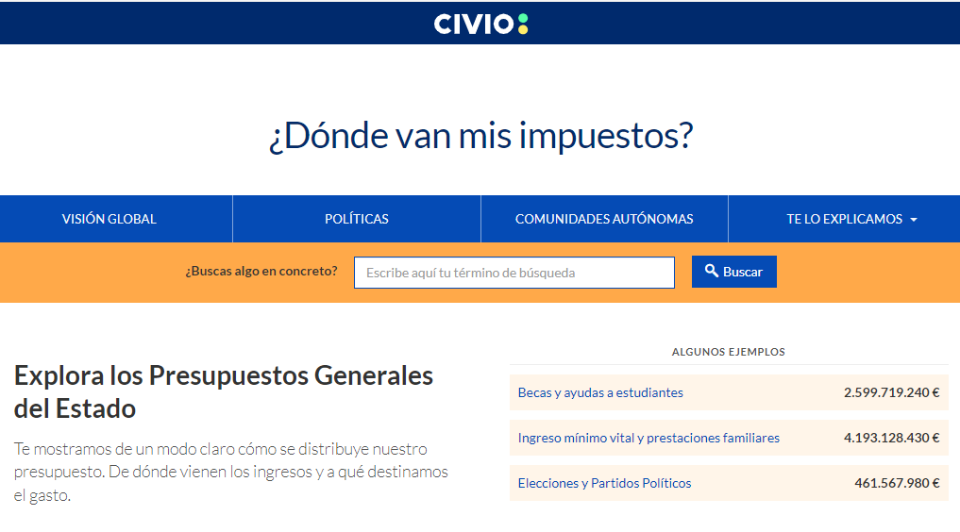
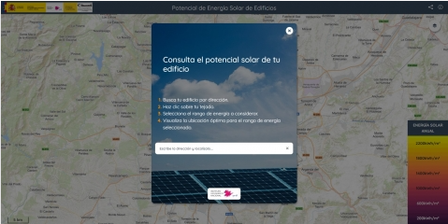
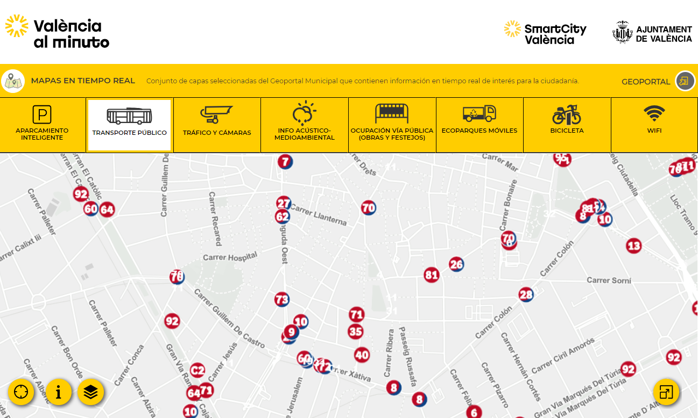
THE USE OF OPEN DATA
FOR CITIZENSHIP
Citizens benefit from improvements in public services and from the wealth generated by companies, while at the same time they have access to accurate and verified information.
EXAMPLES
Budgetary viewfinders that boost transparency and accountability
Solutions that help you make better decisions, and that can save you money
Applications that provide closer and more efficient services

Slide 15

WHAT IS THE RELATIONSHIP BETWEEN
OPEN DATA AND TRANSPARENCY?
Open data and transparency are two key elements in creating open government, but they should not be confused:
When we talk about transparency, we refer to the access to and consultation of public information that seeks accountability
Opendata goes one step further and aims to enable the re-use of such information, and should therefore be in an open and free, machine-readable format.
Re-use of data as added value on the right of access
Law 19/2013, of 9 December, on transparency, access to public information and good governance.
Law 37/2007 of 16 November 2007 on the re-use of public sector information

Slide 16

WHAT IS THE
INITIATIVA APORTA?
EUROPEAN STRATEGY
Digital Agenda for Europe / European Directives / Publishing standards, privacy / European Data Strategy / IA Law…
The Aporta Initiative is the national strategy for coordinating and promoting the opening up of data from the public sector, and for promoting the development of advanced services based on it.
NATIONAL STRATEGY
Digital Agenda for Spain / AI Strategy / Law 37/2007 / Open Government Plan
GOALS
Promote and coordinate the opening of data generated by the public sector.
Stimulate a market linked to the re-use of public sector information.
Contribute to favouring the conditions for the development of the European Data Strategy in Spain.
ACTION PLAN

Slide 17

WHO IS INVOLVED?
The Aporta Initiative works with international, national, public and private sector actors through an inclusive governance model.
DATA MANAGERS
INTERNATIONAL EFFORTS
OF OPEN DATA
REUSERS
PUBLIC SECTOR
State
Autonomies
Local
Universities
Companies
Entrepreneurs
Public administrations
Civil society
Universities
Citizens
PRIVATE SECTOR
NATIONAL COORDINATION GROUPS
Associations
business
Organisations of the
civil society
Working groups
CAAC
Network of entities
premises
Information
universities

Slide 18








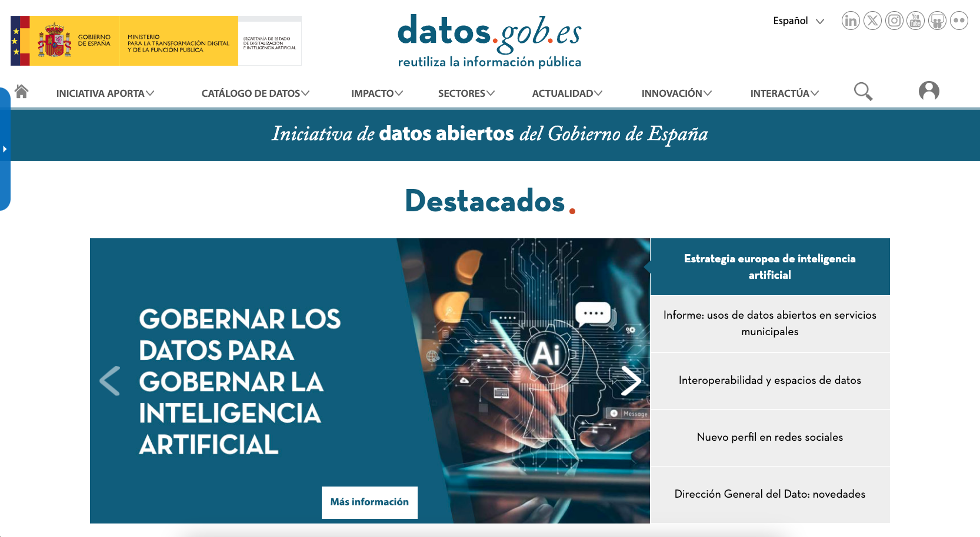
wHAT ACTIONS ARE BEING DEVELOPED?
The Aporta Initiative is developed along 7 lines of action..
National Catalogue
and Support
Sensitisation
Regulation
National
Cooperation
International
cooperation
Analysis and
Statistical
Innovation
... which are reflected in datos.gob.es
Meeting point between administrations, companies and citizens that form part of the open data ecosystem in Spain
datos.gob.es is the platform managed by the Aporta Initiative.

Slide 19

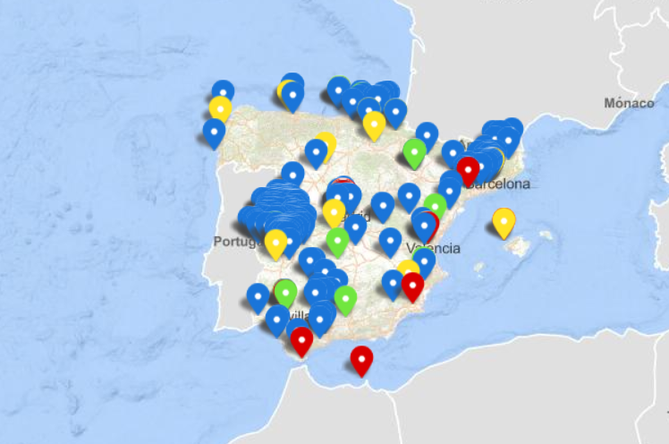
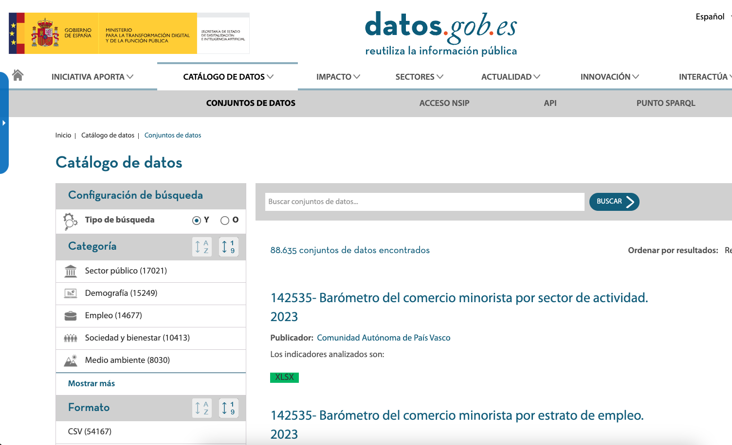
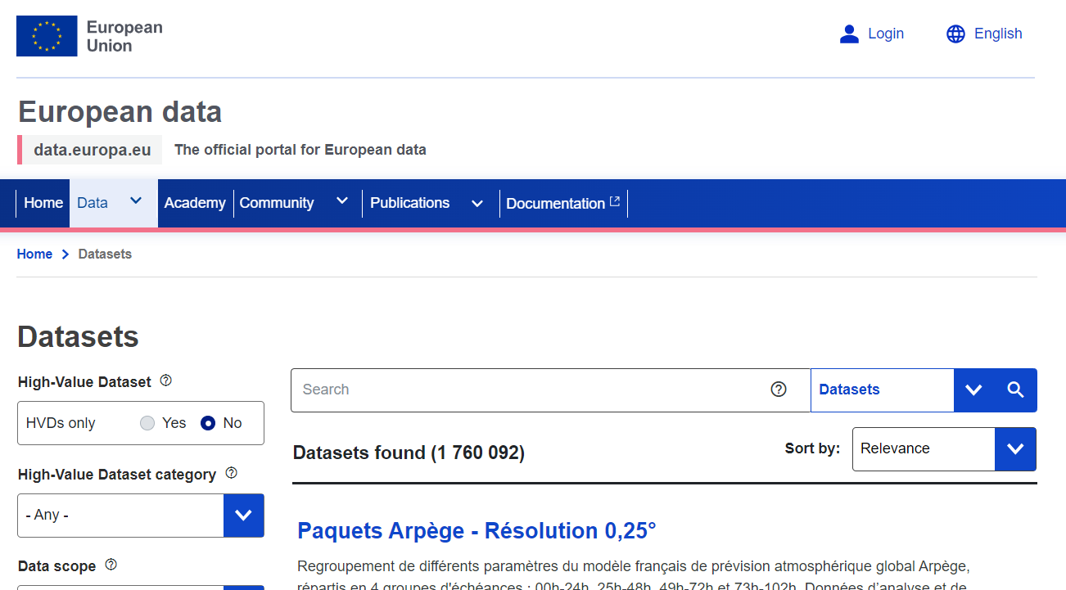
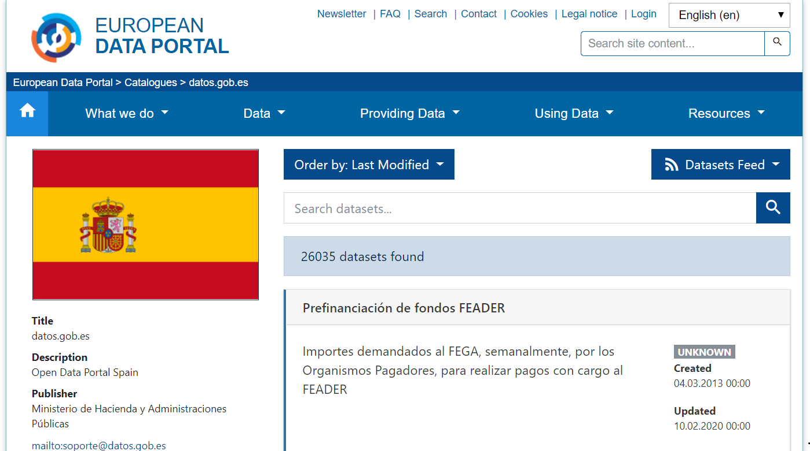
NATIONAL OPEN DATACATALOGUE
Datos.gob.es hosts the National Catalogue of open data, an access point to more than 80,000 datasets that the Spanish public administration makes available for reuse.
Communication channel with the
european data portal
National data initiatives
Access point
European users can access data on Spanish initiatives through the EDP
Federate your datasets with datos.gob.es
Federate your datasets with the EDP

Slide 20


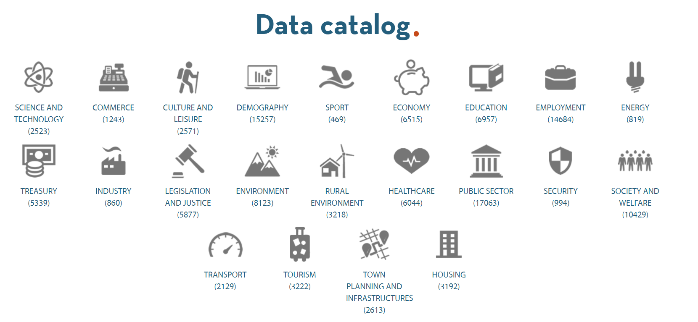

NATIONAL OPEN DATA CATALOGUE
Multiple mechanisms for locating and accessing relevant data
The "Single National Information Point"has also been launched, where citizens, business, people or researchers can search for and find information on protected public sector data.

Slide 21








WE ARE AT THE SERVICE OF USERS
Qualified technical support is also provided to help publishers overcome obstacles and speed up the opening of data.
Listening and interacting with the user is one of the main objectives of the Aporta initiative, and there are several mechanisms to achieve this:
Interact
Data availability
Suggestions and improvements
Re-use companies
Applications
Initiatives
E-mail
contacto@datos.gob.es
Telephone number
912 127660
ext. 4422
Do you want to publicise your projects linked to open data and data-driven innovation?
Write to us at dinamizacion@datos.gob.es
E-mail
soporte@datos.gob.es
In-person
Request by mail or
by telephone

Slide 22
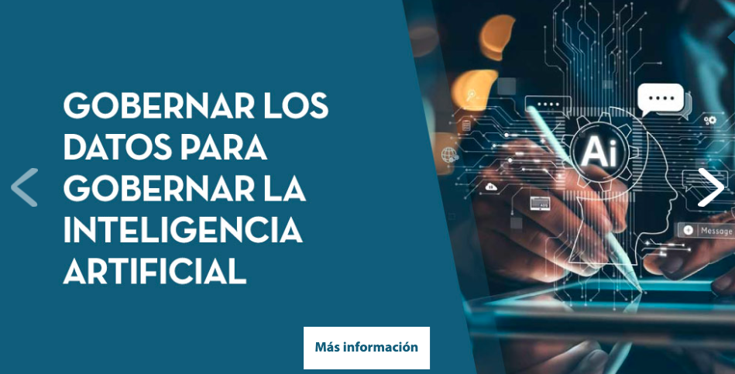
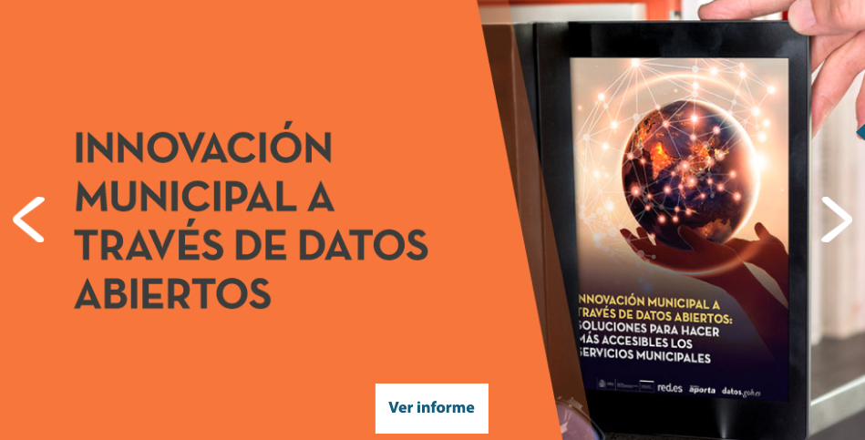
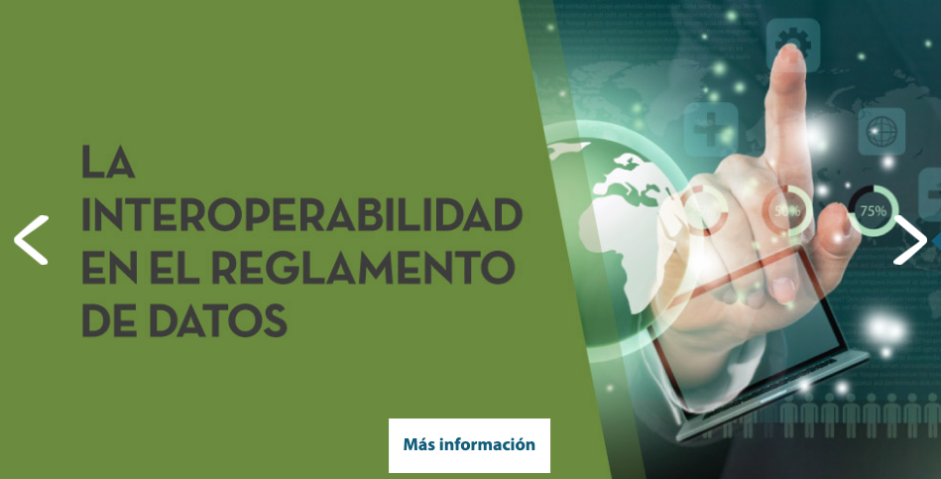
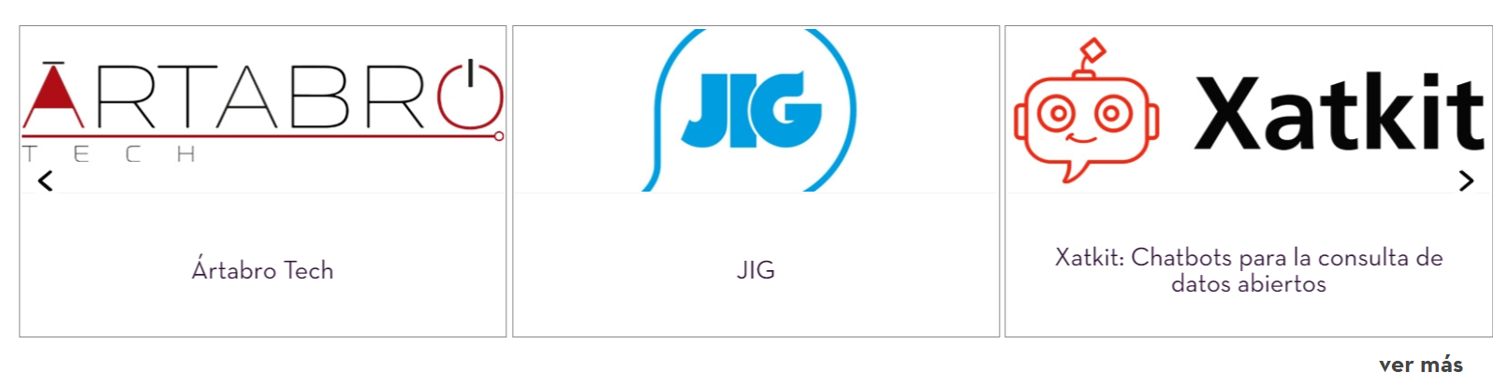
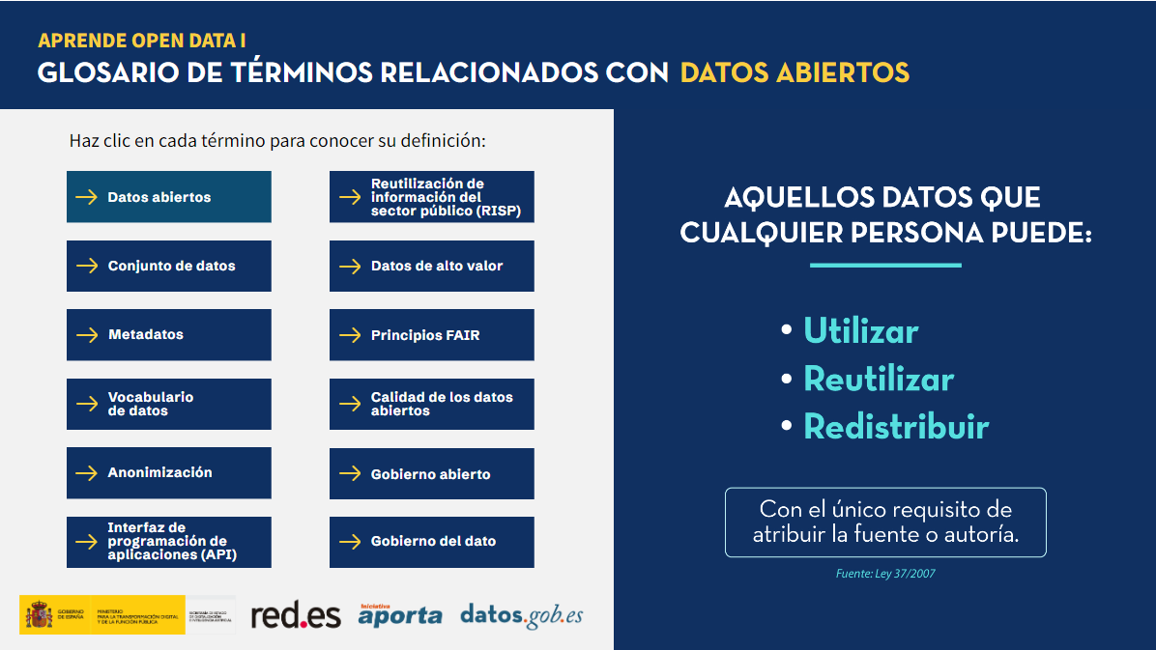


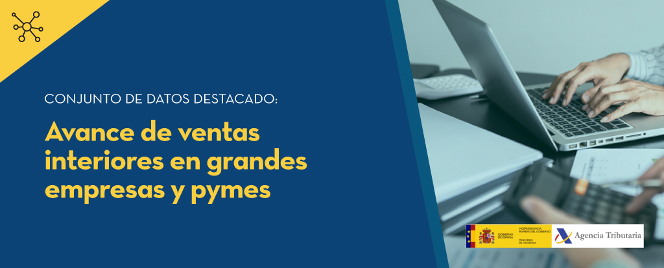
WE BOOST KNOWLEDGE
ABOUT OPEN DATA
datos.gob.es is also a permanent information channel for the open data community in Spain.
Latest trends and developments
News, Interviews, Events, Infographics, Newsletter
Identification and dissemination of use cases
Companies and Applications
Social media
@datosgob
21K followers
@datosgob
datos.gob.es1
12,5K followers
Subscribe to our newsletter
Present
Re-use companies
Guides and training materials, including step-by-step data science exercises
Participation in events
Bimonthly newsletter
Raising awareness of the importance of open data

Slide 23
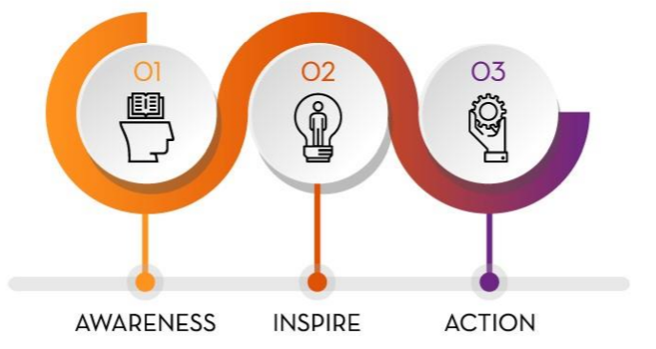
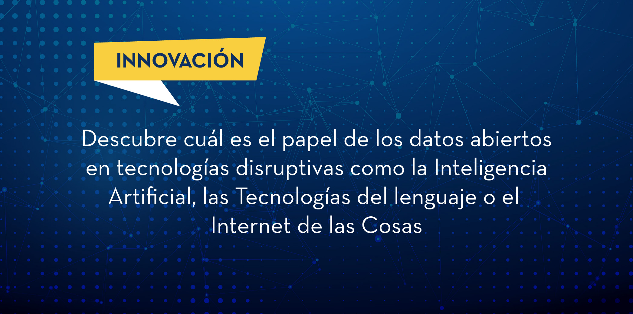
WE SUPPORT DATA-DRIVEN INNOVATION
The Aporta Initiative promotes innovation based on the data value chain:
Data organisation and approach
Opening and making data available
Data processing
Models for the supply of products and services
DESAFÍO APORTA
INNOVATION BLOG
Open idea competitions
for innovation.
Dissemination of innovations linked to disruptive technologies and data.
Content developed by a panel of experts in various subjects, in English and Spanish

Slide 24
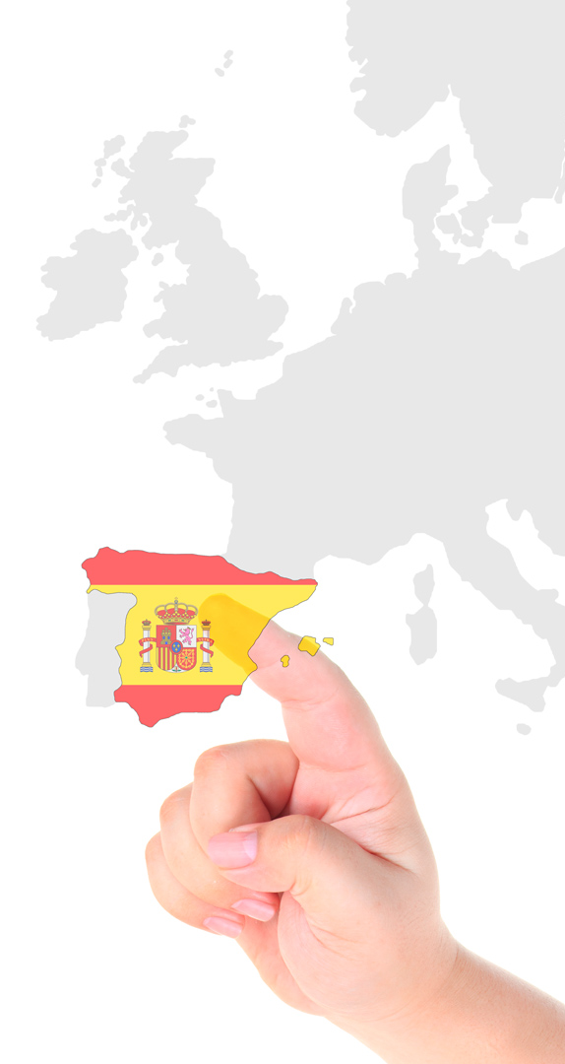
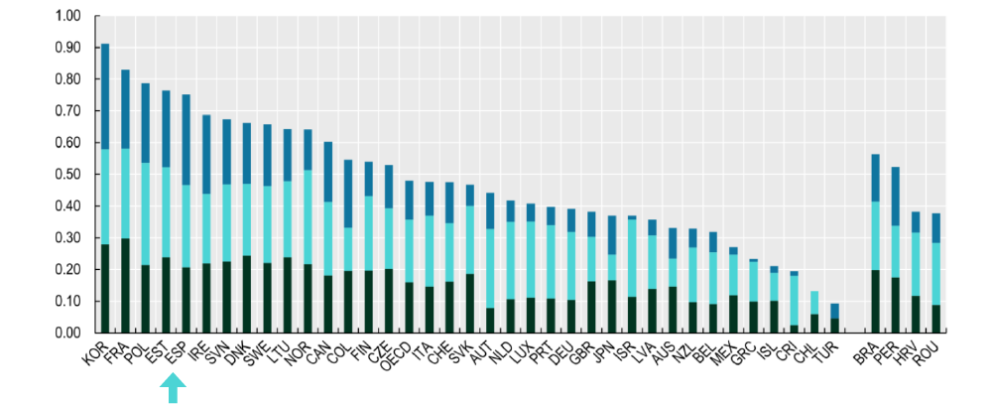
WE HELP TO POSITION SPAIN
The Aporta Initiative monitors data activity in Spain, produces studies and participates in international rankings, such as the European Data Index or OURData INDEX.
Spain among open data leaders according to OECD and European data portal
Source: Ourdata Index, OCDE, 2023

Slide 25

dO YOU WANT TO KNOW MORE ABOUT THE INITIATIVE CONTRIBUTES?
Visit www.datos.gob.es
Instagram: datosgob
X: @datosgob
LinkedIn: datos.gob.es
Subscribe to our newsletter
Subscribe to our newsletter
Write to contacto@datos.gob.es

